Slide 1


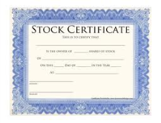

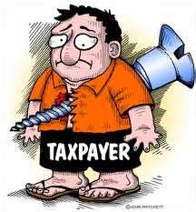


Government
Bailout cash!
Taxes
Stock market
Salary
& Bonuses
Stock certificate
worth ???
Retirement
Savings
Stock sale proceeds
Pension funds, mutual funds, 401 (k)s,
IRAs, etc.
AIG Executives

